Slide 1
FISH270
Lec11

Slide 2
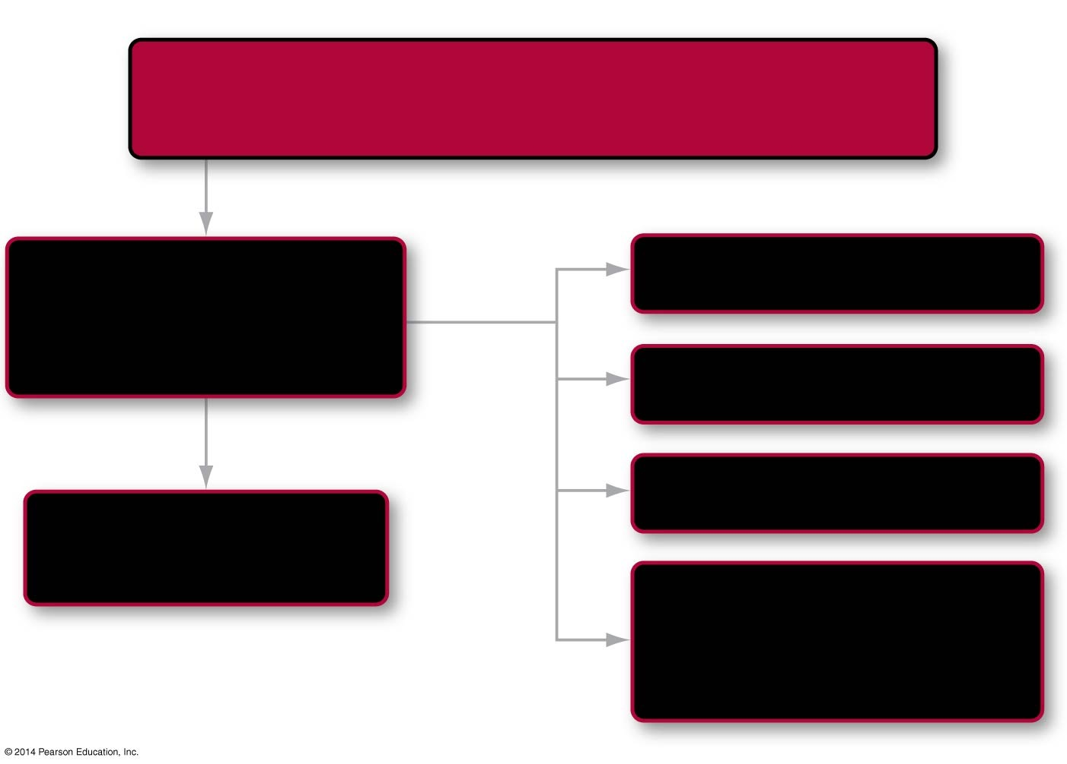

Roadmap 47
In this chapter you will learn how
Animals transform sound, smell, and other stimuli
into signals the brain can understand
by asking
How do sensory organs
convey information
to the brain?
Mechanoreception
47.2
47.1
then
looking
closer
at
Photoreception
47.3
Chemoreception
47.4
Notes:
Chapter 47 Opening Roadmap.

Slide 3
Introduction to Animal Sensory Systems
Sensing changes in the environment and moving in response to this information is fundamental to how animals work
Animals can generally detect five changes in the environment
Smell
Sound—hearing
Sight
Pressure
Temperature changes
Special organs detect these changes and convey information to the central nervous system

Slide 4
Sensory Organs Convey Information to the Brain
The ability to sense a change in the environment depends on three processes:
Transduction, the conversion of an external stimulus to an internal signal in the form of an action potential
Amplification of the signal
Transmission of the signal to the central nervous system (CNS)

Slide 5
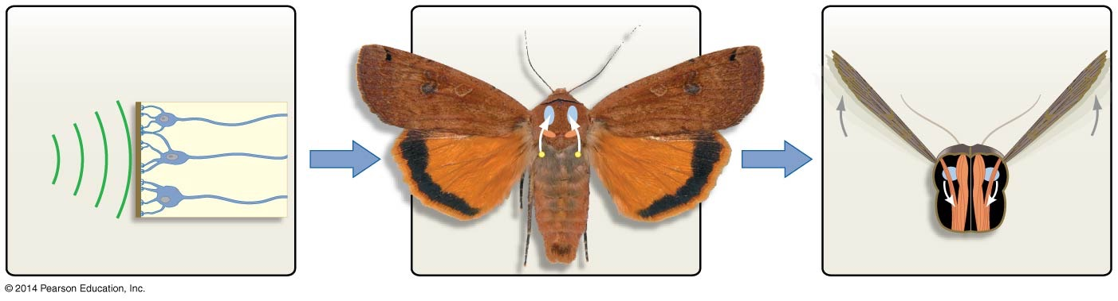
Figure 47.1
Sensory receptors
Central nervous system
Effectors
(Receipt, transduction, and
amplification of signal)
(Integration of information)
(Response to signal)
CNS
Wings
Bat
calls
Sensory
input
Motor
output
CNS
Membrane
of moth ear
Sensory
neuron
Ears
Flight muscles
Cross
section
Top view
Notes:
Figure 47.1 Sensory Systems, the CNS, and Effectors Are Linked.

Slide 6
Sensory Organs Convey Information to the Brain
Each type of sensory information is detected by a sensory neuron or by a specialized receptor cell that makes a synapse with a sensory neuron
Transduction requires a sensory receptor cell to convert light, sound, tension, or some other stimulus into an electrical signal
Sensory receptors are located throughout the body and are categorized by the type of stimulus

Slide 7
Types of Sensory Receptors
Many types of sensory receptors convey the change in the environment into electrical signals
Nociceptors sense harmful stimuli such as tissue injury
Thermoreceptors detect changes in temperature
Mechanoreceptors respond to distortion caused by pressure
Chemoreceptors perceive the presence of specific molecules
Photoreceptors respond to particular wavelengths of light
Electroreceptors detect electrical fields
Magnetoreceptors detect magnet fields

Slide 8
Sensory Transduction
When cells are in the resting state, the inside of the plasma membrane is more negative than the exterior
If ion flows cause the interior to become more positive (less negative), the membrane is depolarized
If changes in ion channels cause the cell interior to become more negative than the resting potential, the membrane is hyperpolarized

Slide 9
Sensory Transduction
The change in potential allows different types of stimuli to be transduced to a common type of signal—one that can be interpreted by the brain
If a sensory stimulus induces a large change in a sensory receptor’s membrane potential, there is a change in the firing rate of action potentials sent to the brain

Slide 10
Sensory Transduction
The amount of depolarization or hyperpolarization of the sensory receptor is proportional to the intensity of the stimulus
For example, the amount of depolarization that occurs in a sound-receptor cell is proportional to the loudness of the sound

Slide 11
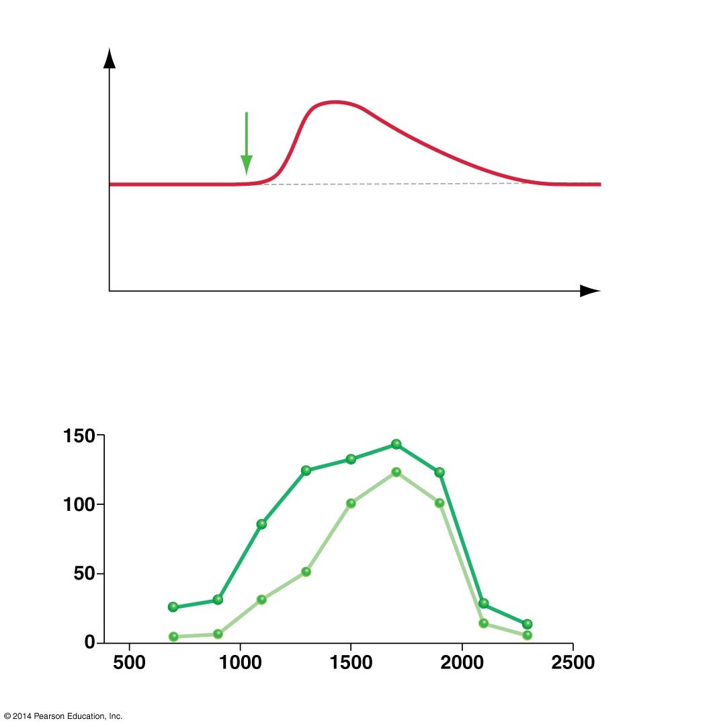
Figure 47.2
(a) Sound-receptor cells depolarize in response to sound.
Sound
stimulus
Less
negative
Membrane potential
(mV)
Depolarized
More
negative
Time (msec)
(b) Sound-receptor cells respond more strongly to louder sounds.
Louder sound
Number of action
potentials per second
Softer sound
Frequency (Hz)
Notes:
Figure 47.2 Sensory Inputs Change the Membrane Potential of Receptor Cells.

Slide 12
Transmitting Information to the Brain
Receptor cells tend to be highly specific
Each type of sensory neuron sends its signal to a specific portion of the brain
Different regions are specialized for interpreting the various stimuli
For example, sound is interpreted in the temporal lobes
Sight is interpreted by the occipital lobes at the back of the brain

Slide 13
Mechanoreception: Sensing Pressure Changes
There are a variety of organs or cells that sense changes in pressure
The statocyst of a crab is a sac filled with fluid and lined with pressure receptor cells
The statocyst also contains a calcium-rich substance that rests on the bottom
When flipped over, the calcium substance bumps up against the receptor cells, which send an action potential to the brain
The response is to turn the crab upright

Slide 14
Mechanoreception: Sensing Pressure Changes
Pressure-sensing systems are used for a variety of changes in the environment, such as
Hearing
Physical pressure on the skin
The movement of muscles
The stretching of blood vessels

Slide 15
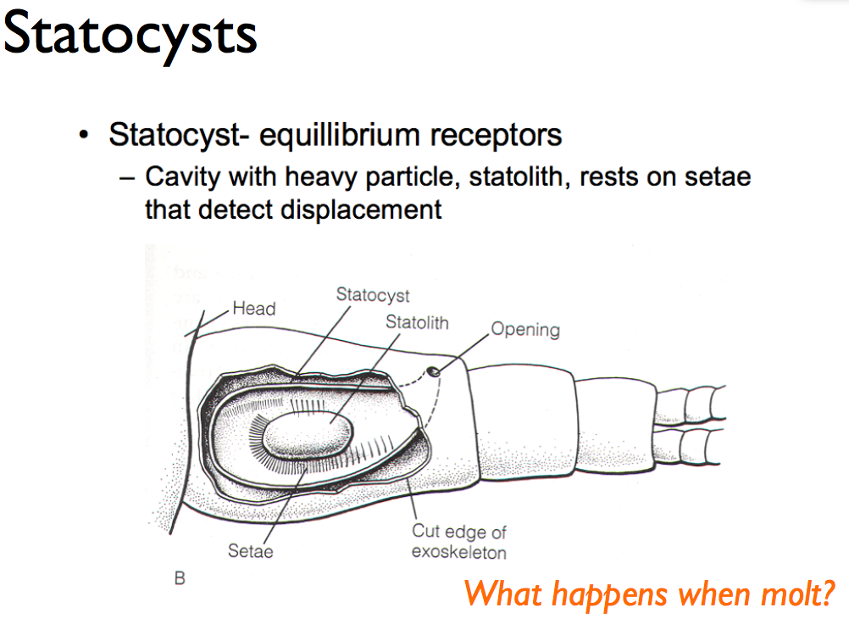

Slide 16
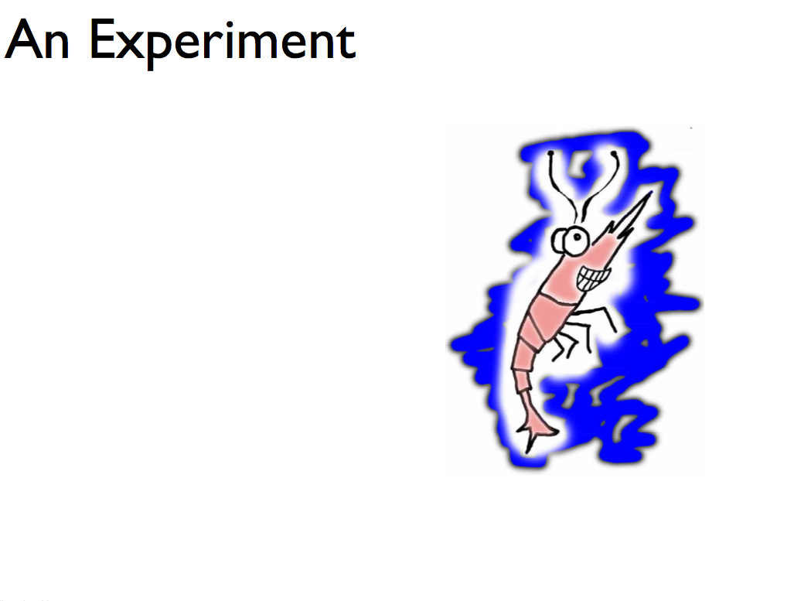

Slide 17
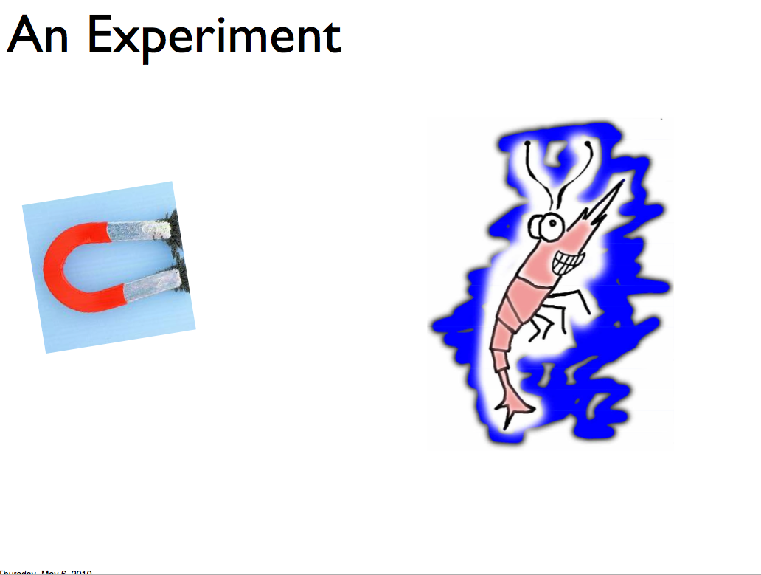

Slide 18
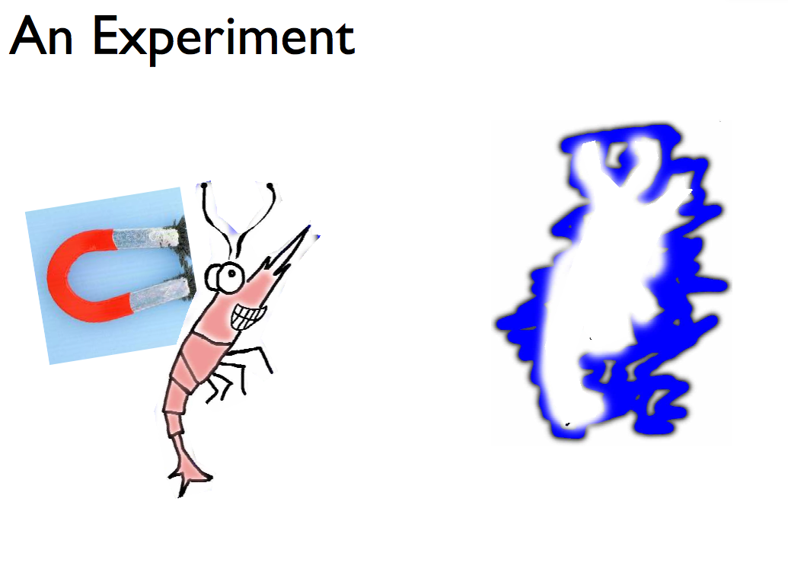

Slide 19
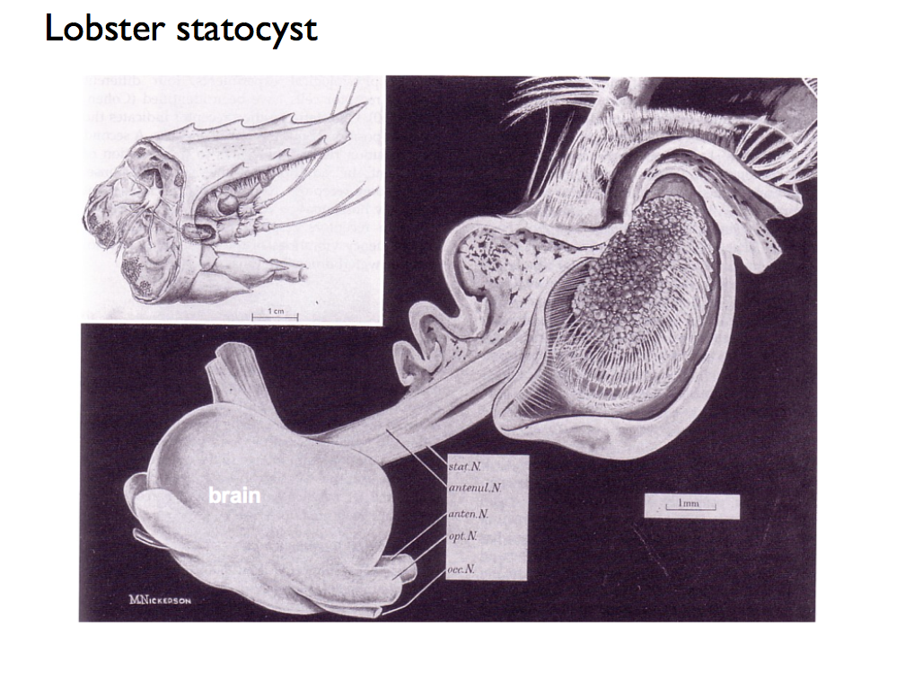

Slide 20
How Sensory Cells Respond to Pressure Changes
The pressure change affects the plasma membrane, which causes ion channels to open or close
This further causes ions to flow in or out
The ion flow then causes depolarization or hyperpolarization
In vertebrates, ion channels are found in the hair cells
Hair cells are pressure receptor cells

Slide 21
Signal Transduction in Hair Cells
Depolarization of the hair cell causes a movement of calcium ions in three ways:
Causes an increase in release of neurotransmitter at the synapse between the hair cell and the sensory neuron
The postsynaptic cells become excited and fire an action potential to the brain, affecting afferent neurons
The afferent neurons are part of the PNS, which conveys information to the CNS
If hyperpolarization occurs, the action potential is inhibited

Slide 22
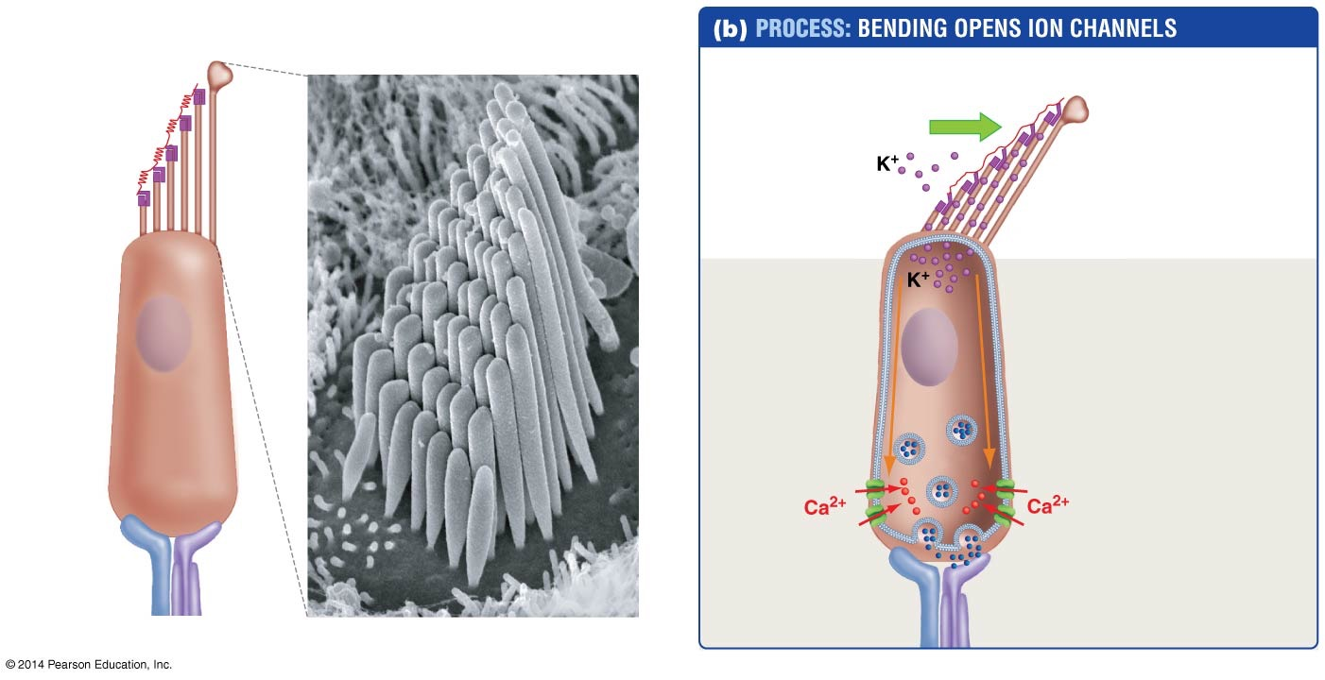
Figure 47.3
(a) Hair cells have many stereocilia and one kinocilium.
Kinocilium
1. Pressure wave
bends stereocilia.
Pressure wave
Stereocilia
2. Potassium
channels open.
Potassium
channels
joined by
protein
“threads”
3. Membrane
depolarizes.
Depolarization
Nucleus
4. Calcium
flows in.
Hair cell
Synaptic
vesicle
Calcium
channel
5. Synaptic
vesicles fuse.
Afferent
sensory
neuron
Efferent
neuron
1 µm
Neurotransmitter
released into
synapse
Afferent
neuron
(to brain)
6. Neurotransmitter
is released.
Notes:
Figure 47.3 Hair Cells Transduce Sound Waves to Electrical Signals.

Slide 25
Hearing: The Mammalian Ear
The best-studied type of pressure sensing is called hearing
Hearing is the ability to sense sound, which consists of waves of pressure in air or water
The number of pressure waves that occur in one second is called the frequency of the sound
We perceive differences in sound frequency as different pitches
Virtually all animal pressure-sensing systems are based on the same mechanism, a mechanoreceptor cell that responds to pressure

Slide 26
Hearing: The Mammalian Ear
The ear transduces sound waves into action potentials and sends the information to the brain
The human ear
Is made up of the outer ear, middle ear, and inner ear, each separated from the others by a membrane
The outer ear, which projects from the head, collects pressure waves and funnels them into the ear canal, where they strike the tympanic membrane, or eardrum, which separates the outer ear from the middle ear

Slide 27
The Structure of the Human Ear
The tympanic membrane vibrates with the same frequency as the sound waves and passes the vibrations to three tiny bones called the ear ossicles, which vibrate against one another
The last ossicle, the stapes, vibrates against the oval window—the membrane that separates the middle ear from the inner ear
In response, the oval window generates waves in the fluid inside a chamber called the cochlea
Hair cells in the cochlea sense these pressure waves

Slide 28
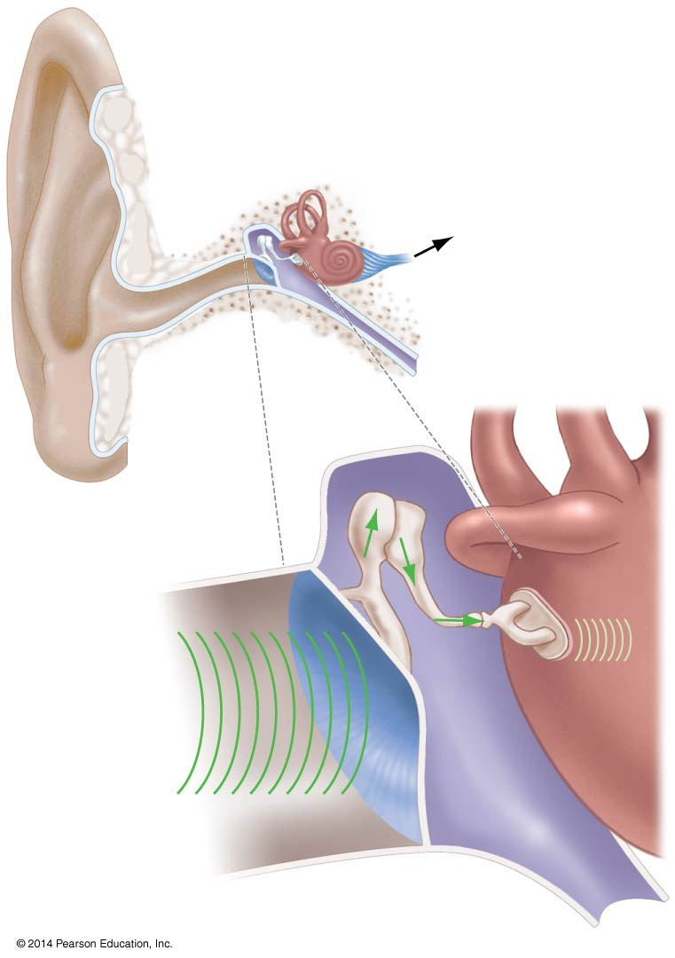
Figure 47.4
Outer
ear
Middle
ear
Inner
ear
Auditory
neurons
(to brain)
Cochlea
Ear canal
Ear ossicles
Oval
window
Stapes
Sound
waves
(in fluid)
Sound
waves
(in air)
Middle
ear cavity
Cochlea
Tympanic membrane
(eardrum)
Notes:
Figure 47.4 Mammals Have an Outer Ear, Middle Ear, and Inner Ear.

Slide 29
Amplification of the Sound Waves
Because the tympanic membrane is about 15 times larger than the oval window, the amount of vibration induced by sound waves is increased by a factor of 15 by passing through the middle ear
The three ossicles further amplify the vibrations from the typmpanic membrane
The overall effect is an amplification by a factor of 22 times, which stimulates the hair cells of the cochlea

Slide 30
Detecting the Frequency of Sounds
The cochlea has a set of internal membranes that divide it into three chambers
Hair cells form rows in the middle chamber
The bottom of each hair cell connects to a structure called the basilar membrane
The stereocilia of the hair cells also touch another smaller surface called the tectorial membrane

Slide 31
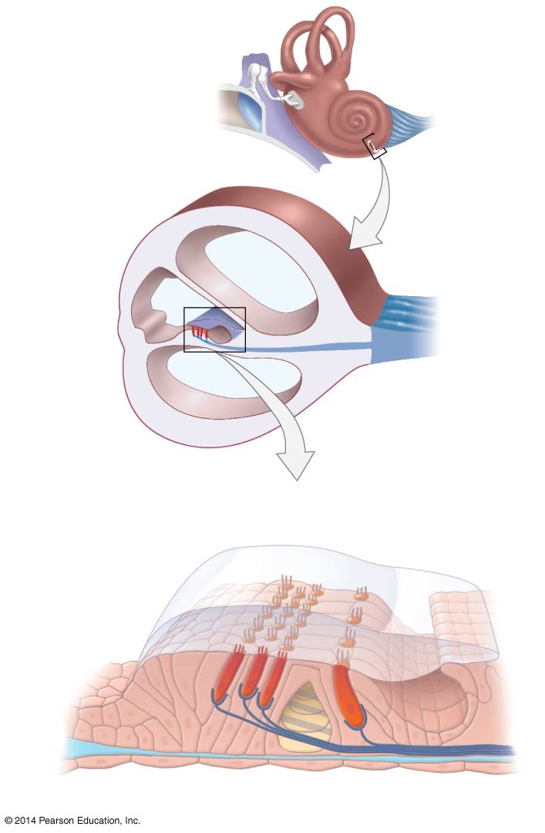
Figure 47.5
(a) The middle chamber
of the fluid-filled cochlea
contains hair cells.
Cochlea
Auditory
nerve
(to brain)
Three
fluid-filled
chambers
Neurons
(of auditory
nerve)
Tectorial
membrane
Hair cells
(b) Hair cells are sandwiched
between membranes.
Stereocilia
Tectorial
membrane
Hair cells
Basilar membrane
Axons of sensory neurons
Notes:
Figure 47.5 The Human Cochlea Contains Fluid-Filled Chambers Separated by Membranes.

Slide 32
The Cochlea Detects the Frequency of Sounds
The basilar membrane varies in stiffness, and sounds of different frequencies cause the membrane to vibrate maximally in specific spots along its length
Resulting in the bending of hair-cell stereocilia
Thus hair cells in particular places on the membrane respond to certain frequencies
These differences are interpreted by the brain as different pitches

Slide 33
The Cochlea Detects the Frequency of Sounds
Complex sounds contain a wide variety of frequencies and trigger particular combinations of hair cells
Through experience, the brain learns which frequency combinations represent certain sounds

Slide 34
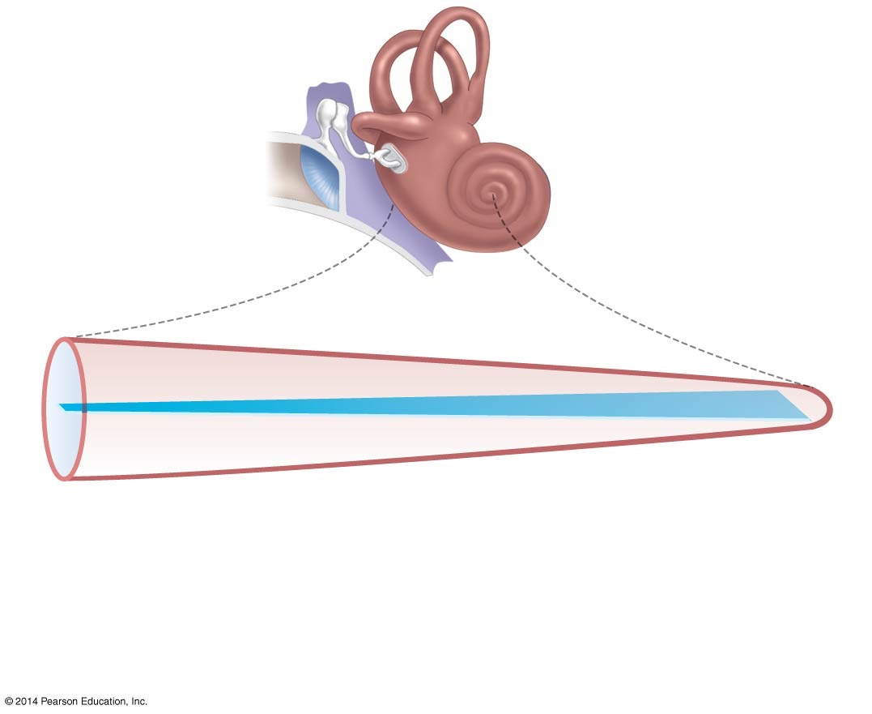
Figure 47.6
Oval window
Cochlea
Base of cochlea
(near oval
window)
Uncoiled cochlea
Basilar membrane
20,000 Hz
2000 Hz
200 Hz
20 Hz
Narrow part of basilar
membrane is stiff—
vibrates in response
to high frequencies
Wide part of basilar
membrane is flexible—
vibrates in response
to low frequencies
Notes:
Figure 47.6 The Basilar Membrane Varies in Stiffness.

Slide 35
Sensory Worlds: What Do Other Animals Hear?
Compared with the hearing of many mammals, human hearing is not particularly acute
Humans can hear sounds between 20 Hz and 20,000 Hz (20 kHz)
Elephants use infrasounds (sound frequencies too low for humans to hear) to communicate
Bats use ultrasonic sounds (sound frequencies too high for humans to hear) to echolocate (navigate by sound)
Hair cells in the lateral line system allow fishes and amphibians to sense pressure changes in water

Slide 36
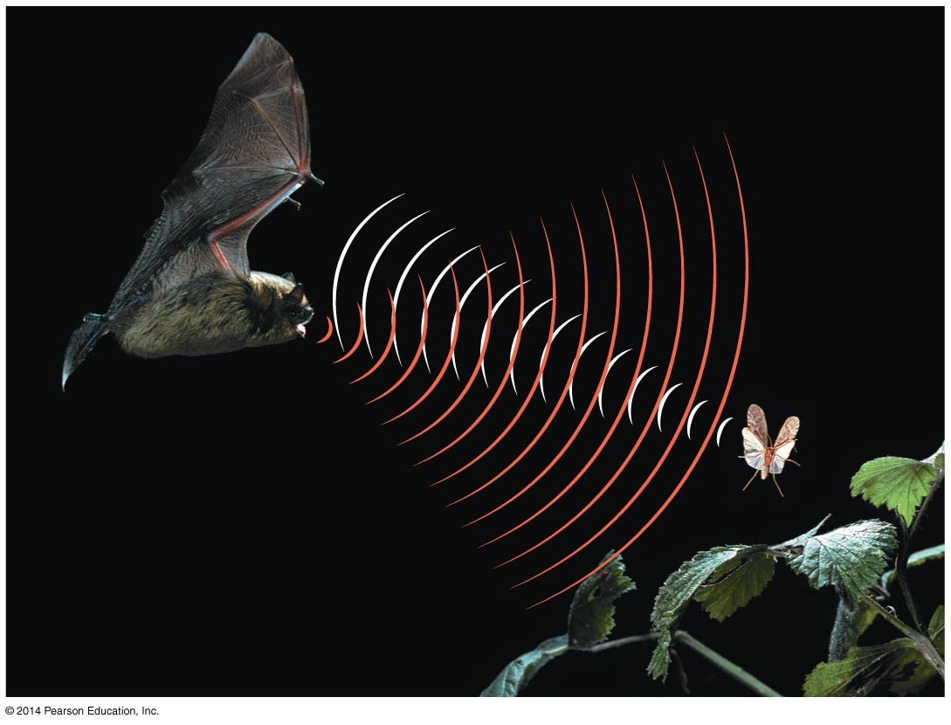
Figure 47.7
Bat sonar
Returning sound waves
Notes:
Figure 47.7 Bats Emit Ultrasonic Sound Waves That Bounce Off Surfaces.

Slide 37
The Lateral Line System in Fish and Amphibians
Fish and larval amphibians have a lateral line that detects changes in pressure
The lateral line contains hair cells
The bending of the cilia produce an action potential in the sensory neurons to the brain
Aquatic animals get information about pressure changes at specific points along the head and body

Slide 38
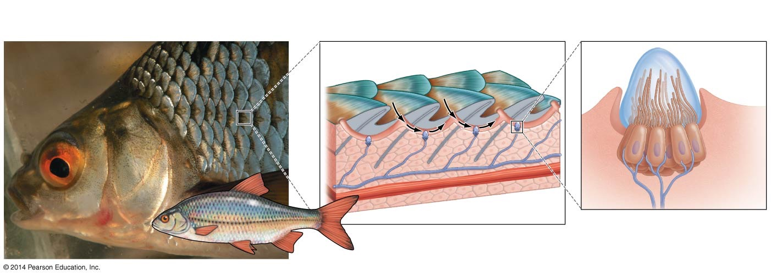
Figure 47.8
(a) The lateral line system consists of a series
of canals running along the head and body.
(b) Water enters the canals through pores and bends
kinocilia on hair cells, activating sensory neurons.
Pore
Lateral line canal
Hair cells
Cupula
Water
Kinocilium
Water
Stereocilia
Hair
cell
Sensory
neuron
Nerve
Notes:
Figure 47.8 The Lateral Line System Detects Pressure Waves in Water.

Slide 39
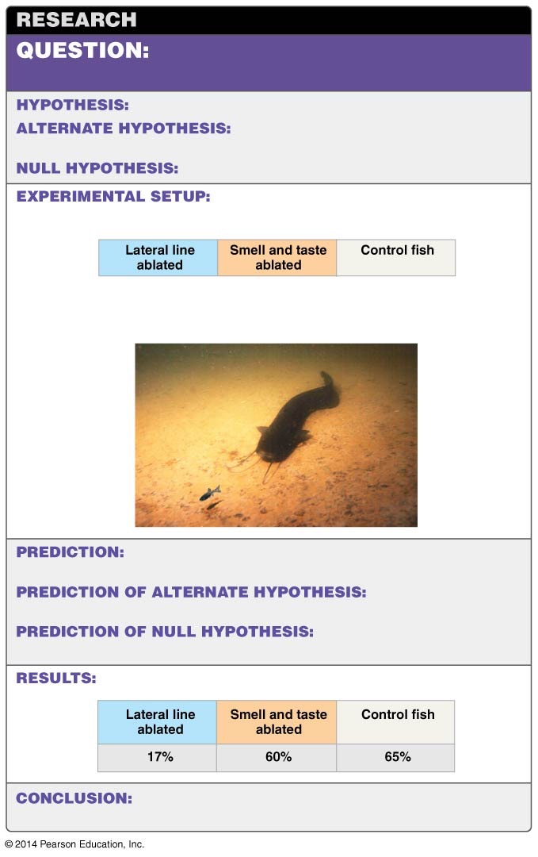
Figure 47.9
What cues do predatory fish use to
detect prey at night?
Predatory fish detect prey using the lateral line system.
Predatory fish detect prey using smell
and taste.
Predatory fish use neither sense to detect prey.
1. Three experimental groups of catfish (n=16 for each group):
2. Acclimate catfish to dark tank at night.
3. Add guppies to tank and record capture success rate.
Fish with their lateral line ablated will have lower
capture success than control fish.
Fish with smell and
taste ablated will have lower capture success than control fish.
There will be no capture
success difference among groups.
Nocturnal predatory catfish use the lateral line system
to detect prey.
Notes:
Figure 47.9 The Lateral Line System Is Used for Predation.

Slide 40
Photoreception: Sensing Light
The organs involved range from simple light-sensitive eyespots to sophisticated, image-forming eyes
A species’ sensory abilities correlate with the environment it lives in and its mode of life—how it finds food and mates
For example, the salamander that lives in forests or meadows has complex eyes
Cave dwellers may have no functional eye
The insect eye is compound
The mammalian eye is a single-lens structure

Slide 41
The Insect Eye
Insects have a compound eye, which is composed of hundreds or thousands of light-sensing columns called ommatidia
Each ommatidium has a lens that focuses light onto a small number of receptor cells—usually four—that in turn send axons to the brain
Each ommatidium contributes information about one small piece of the visual field

Slide 42
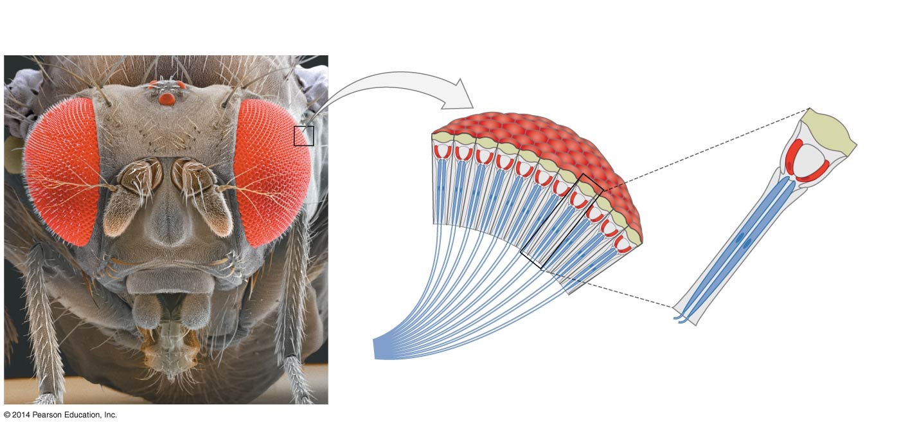
Figure 47.10
(a) Ommatidia are the functional units
of insect eyes.
(b) Each ommatidium contains receptor cells that send
axons to the CNS.
Ommatidia
Lens
Receptor
cells
Axons
Notes:
Figure 47.10 In the Compound Eyes of Insects, Each Ommatidium Sees Part of the Visual Field.

Slide 43
The Vertebrate Eye
Compound eyes are thought to have evolved once, in the ancestor of today’s arthropods
They are found in insects, crustaceans and other arthropods
The camera eye, on the other hand, evolved independently in two widely divergent groups:
The cephalopod mollusks (squid and octopuses)
The vertebrates
The camera eye is a structure that focuses incoming light onto a layer of receptor cells
It is also known as a simple eye

Slide 44
The Structure of the Vertebrate Eye
The outermost layer of the eye is tough, white tissue called the sclera
This is the “white of the eye”
The front of the sclera forms the cornea, a transparent sheet of connective tissue
Just inside the cornea is a colored, round muscle called the iris
The iris can contract or expand to control the amount of light entering the eye

Slide 45
The Structure of the Vertebrate Eye
The hole in the center of the iris is the pupil
Light enters the eye through the cornea, passes through the pupil, and strikes a curved, clear lens
Together, the cornea and lens focus incoming light onto the retina in the back of the eye

Slide 46
The Structure of the Vertebrate Eye: The Retina
The retina comprises three distinct, synapsing cell layers:
Light-sensitive photoreceptors, which form a layer at the back of the retina
These cells respond to light
An intermediate layer of connecting neurons called bipolar cells
Ganglion cells, which form the front or innermost layer of the retina and whose axons project to the brain via the optic nerve

Slide 47
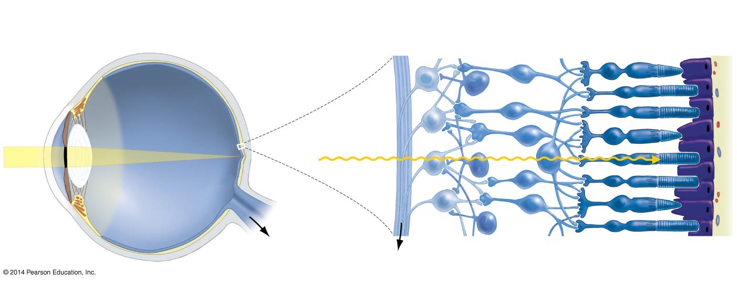
Figure 47.11
(a) The structure of the vertebrate eye
(b) In the retina, cells are arranged in layers.
Photoreceptor
cells
Pigmented
epithelium
Ganglion cells
Bipolar cells
Sclera
Retina
Iris
Pupil
Direction of light
Cornea
Fovea
Lens
Optic nerve
(to brain)
Axons of optic nerve
Notes:
Figure 47.11 Simple Eyes Have a Single Lens That Focuses Incoming Light on Receptor Cells.

Slide 48
A Flawed Structure?
Although the vertebrate eye is sometimes claimed to be a “perfect” adaptation, optometrists have cataloged a large array of common defects
Vertebrate eyes that are in ideal condition have a curious flaw: the blind spot
This is the photoreceptor-free area where the optic nerve leaves the retina
Cephalopod mollusks have evolved a more efficient camera eye that has no blind spot
Instead, the photoreceptor cells form a continuous layer on the inside of the retina

Slide 49
What Do Rods and Cones Do?
Photoreceptors in the vertebrate eye consist of rods and cones
Rods are sensitive to dim light but not to colors
Cones are much less sensitive to faint light but are stimulated by different wavelengths of light (colors)
Rods dominate most of the retina, but one small spot in the center of the retina—the fovea—has only cones

Slide 50
How Do Rods and Cones Detect Light?
Rods and cones have segments packed with membrane-rich disks that contain large quantities of a transmembrane protein called opsin
Each opsin molecule is associated with a molecule of the pigment retinal
The two-molecule complex is called rhodopsin
Retinal changes shape when it absorbs a photon of light, leading to a change in opsin’s conformation
This change leads to a series of events that culminate in a different stream of action potentials being sent to the brain

Slide 51
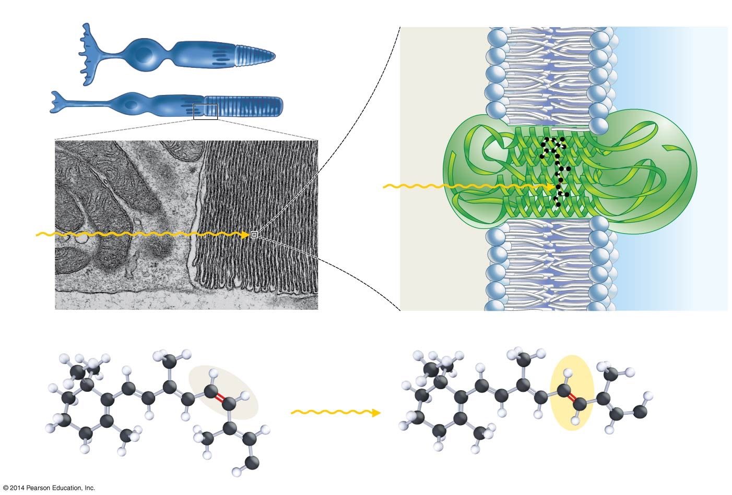
Figure 47.12
(a) Rods and cones contain stacks of membranes.
(b) Rhodopsin is a transmembrane protein complex.
Cone
Opsin
(protein
component)
Rhodopsin
Rod
Light
Light
Retinal
(pigment)
0.5 µm
(c) The retinal molecule inside rhodopsin changes shape when retinal absorbs light.
trans
conformation
(activated)
cis conformation
(inactive)
Light
Opsin
Opsin
Notes:
Figure 47.12 Rods and Cones Are Packed with Transmembrane Proteins That Contain the Pigment Retinal.

Slide 52
How Do Rods and Cones Detect Light?
Light does not open ion channels or trigger the release of a neurotransmitter to a sensory neuron
The molecular basis of vision is a shape change in retinal
This shuts down an existing ion channel
Decreases the amount of neurotransmitter being released to the sensory neuron
Exposure to light transmits information by shutting down both processes

Slide 53
How Light Shuts Down Neurotransmitter Release
Rhodopsin is activated when light causes retinal to change shape
Rhodopsin activates the membrane protein transducin, which in turn activates the enzyme phosphodiesterase (PDE)
PDE breaks down cyclic guanosine monophosphate (cGMP) to guanosine monophosphate (GMP)
As cGMP levels decline, cGMP-gated sodium channels in the plasma membrane of the rod cell close
When sodium channels close, Na⁺ entry decreases and the membrane hyperpolarizes, decreasing neurotransmitter release

Slide 54
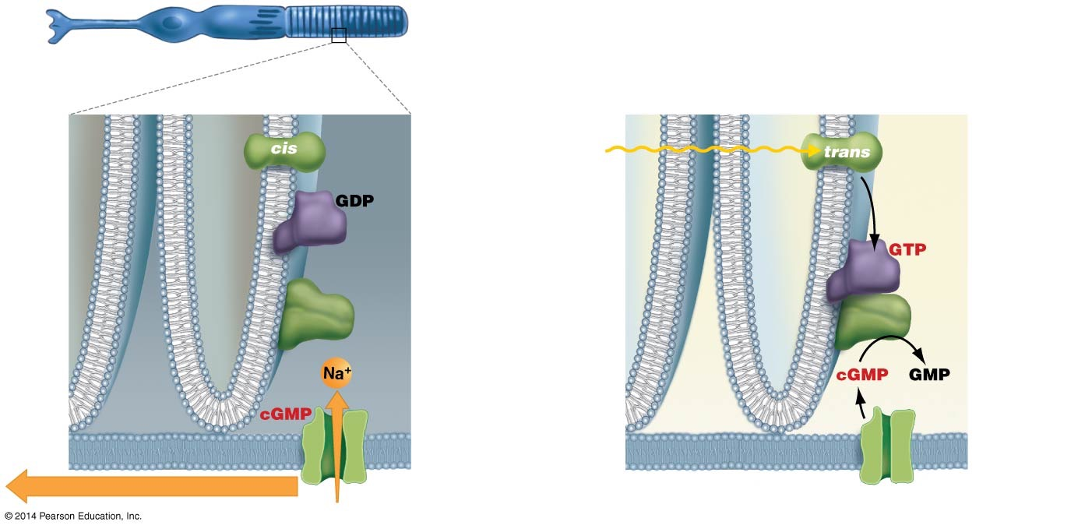
Figure 47.13
Rod
(a) Before stimulation
(no light)
Disk
membranes
(b) After stimulation (light)
Rhodopsin
(inactive)
Light
Rhodopsin
(activated)
Transducin
(inactive)
Transducin
(activated)
PDE
(inactive)
PDE
(activated)
Na⁺
cGMP-gated
sodium
channel
(open)
cGMP-gated
sodium
channel
(closed)
Plasma membrane of rod
Na⁺ current depolarizes membrane
Lack of Na⁺ current hyperpolarizes membrane
Notes:
Figure 47.13 A Signal-Transduction Pathway Connects Light Absorption to Changes in Membrane Potential.

Slide 55
How Light Shuts Down Neurotransmitter Release
The decrease in neurotransmitter indicates to the postsynaptic cell, the bipolar cell, that the rod absorbed light
As a result, a new pattern of action potentials is sent to the brain via the ganglion cells
Axons from ganglion cells are bundled into the optic nerve
A single photon of light can cause a change in membrane potential in the rod cells

Slide 56
Color Vision: The Puzzle of Dalton’s Eye
In the late 18th century, physicist John Dalton suggested a mechanism (later proved incorrect) for his red-green color blindness
With DNA testing, modern researchers determined that Dalton had no functioning M (medium-wavelength) cones

Slide 57
Color Vision: The Puzzle of Dalton’s Eye
We now know that there are three different cone types, each having a different type of opsin
These opsins respond only to distinct wavelengths and thus detect blue, green, or red light (short, medium, and long wavelengths)
Current theory states that the brain distinguishes color by integrating the signals from the three types of opsins

Slide 58

Figure 47.14
No color deficiency
Red–green color deficiency
Notes:
Figure 47.14 People with Red–Green Color Blindness Cannot Distinguish Red from Green.

Slide 59
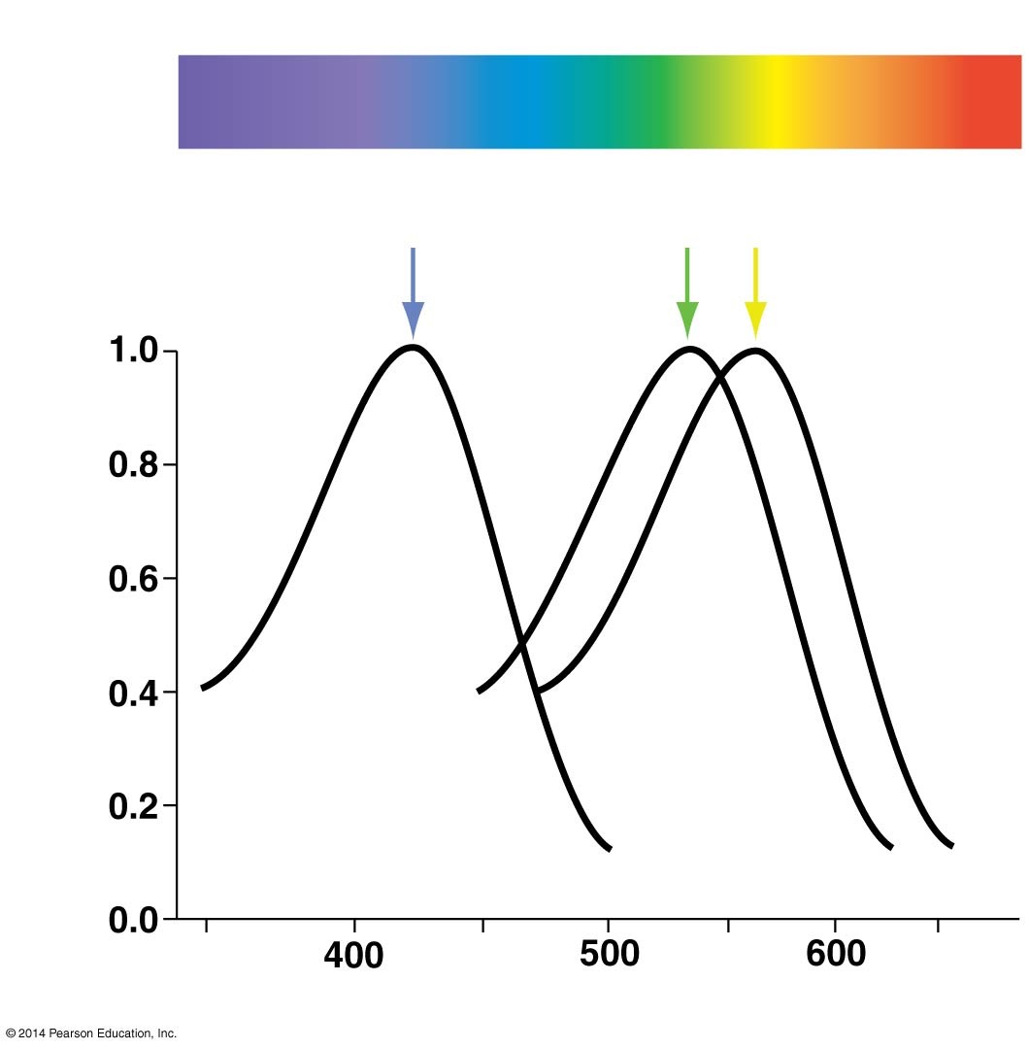
Figure 47.15
Visible spectrum
S opsin
420
M opsin
530
L opsin
560
Relative proportion
of light absorbed
Wavelength (nm)
Notes:
Figure 47.15 Color Vision Is Possible because Different Opsins Absorb Different Wavelengths of Light.

Slide 60

The Vertebrate Eye
Web Activity: The Vertebrate Eye

Slide 61
Do Other Animals See Color?
How well an animal can see color depends on the number of cones and the particular opsins it has
This ability may be determined by their environment
The types of opsins found in a species correlates with the environment it inhabits and its mode of life
Opsins are adaptations—their structure and function vary among species

Slide 62
Other Examples of Color Vision in Animals
Many vertebrate and invertebrate species have four or more types of opsins and probably perceive a world of colors much richer than ours
Examples include
Fish—Coelacanths live in deep water and can see blue light
The blue penetrates to greater depth than other colors
Primates that eat fruit must see green, yellow, and red in order to find ripe fruit
Some insects and birds see in the ultraviolet, which serves as a pollination adaptation because some flowers have ultraviolet patterns

Slide 63
Best vision?

Slide 64
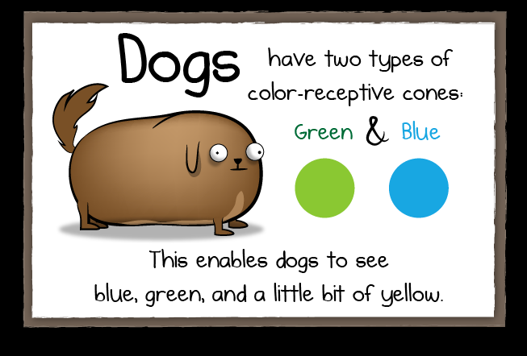

Slide 65
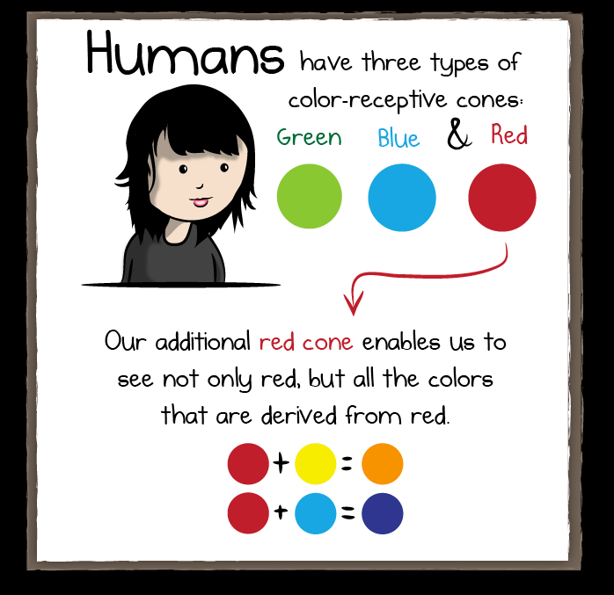

Slide 66
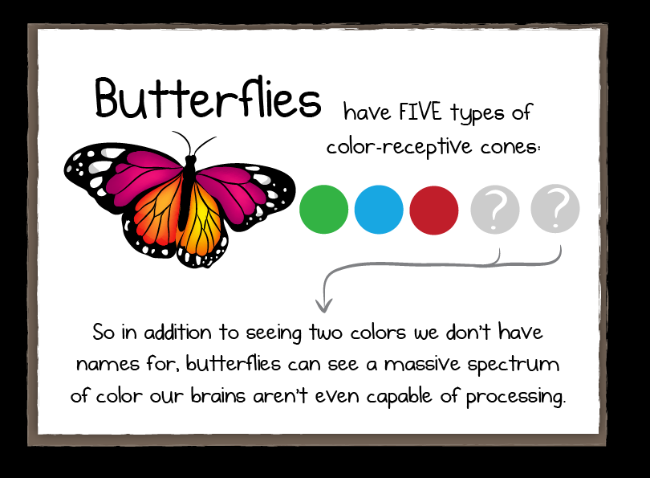

Slide 67
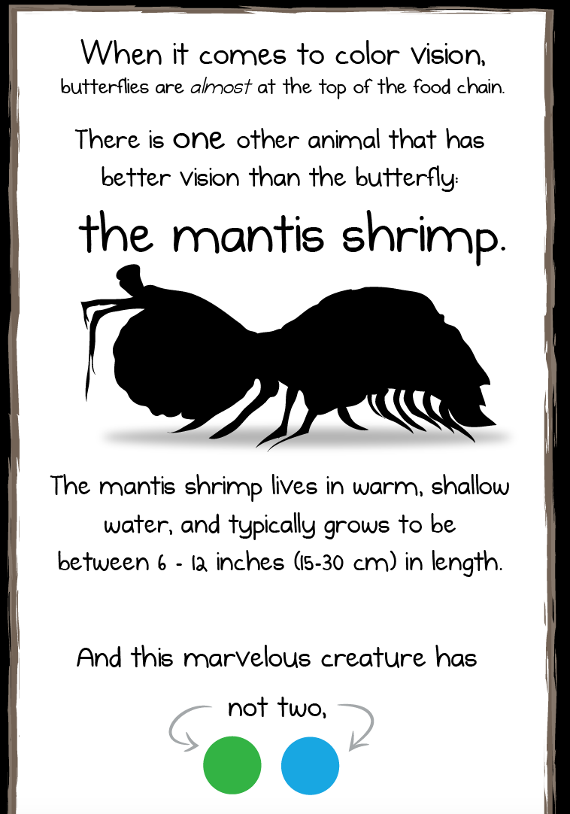

Slide 68
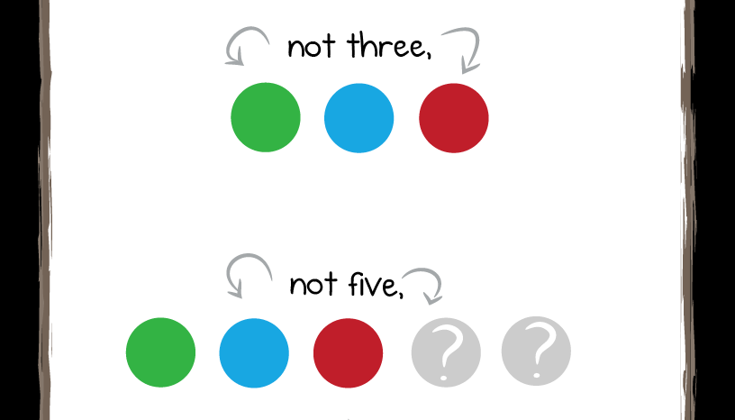

Slide 69


Slide 70
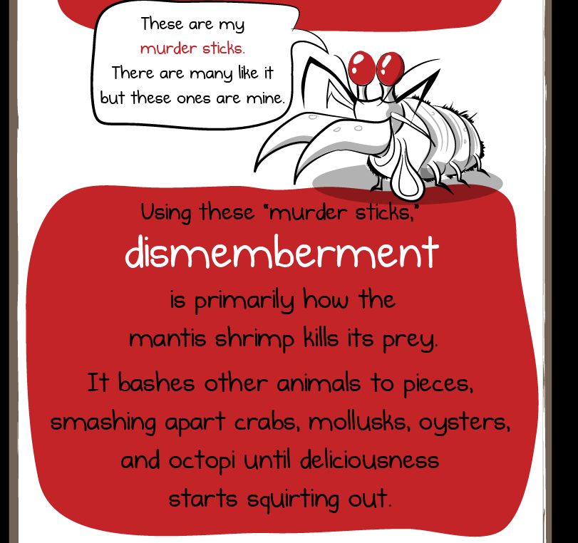

Slide 71
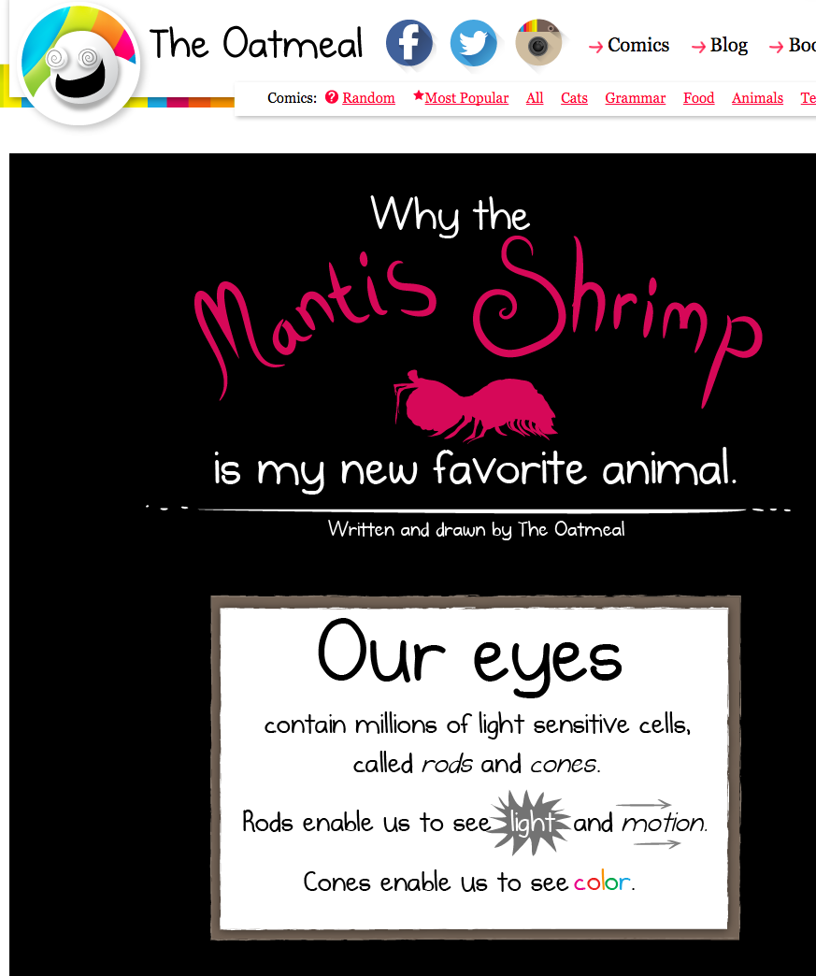

Slide 72
More on vision

Slide 73
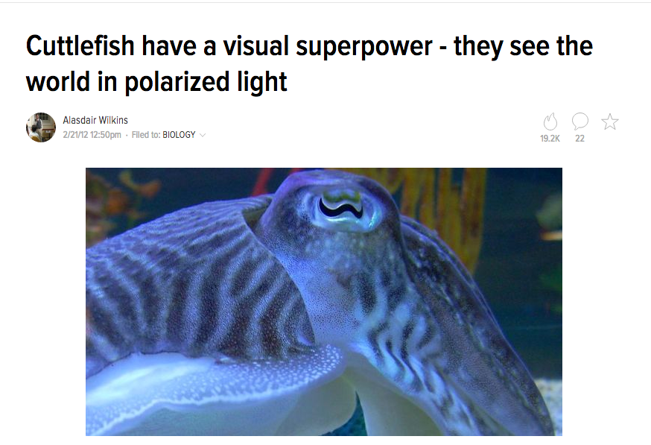

Slide 74
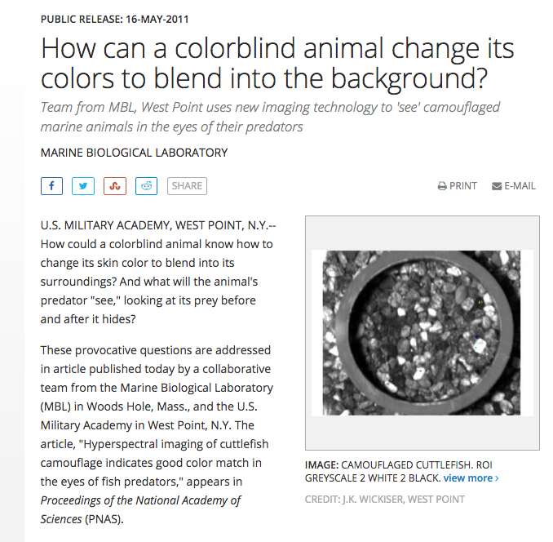

Slide 75
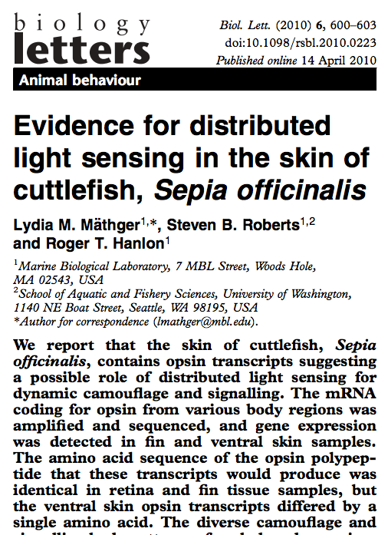

Slide 76
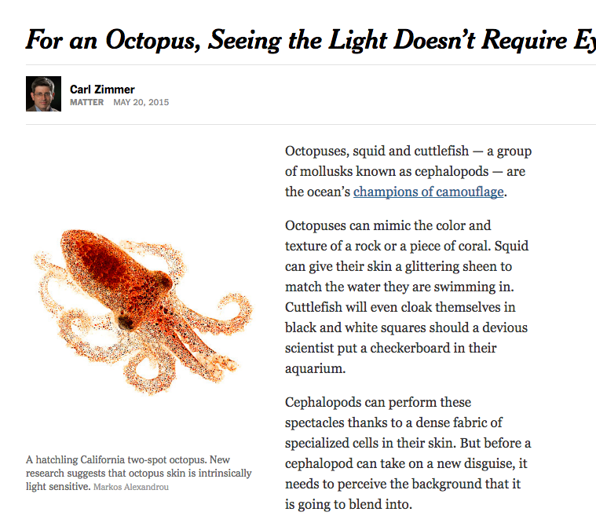

Slide 77
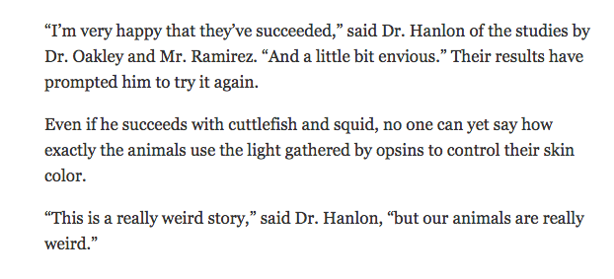

Slide 78
Chemoreception: Sensing Chemicals
The sense of taste (gustation) and the sense of smell (olfaction) originate in chemoreceptors
Chemoreception is the result of the molecule binding to the chemoreceptor and initiating an acton potential
The molecules causes a change in the membrane potential and transduction takes place, changing the chemoreception to an electrical signal

Slide 79
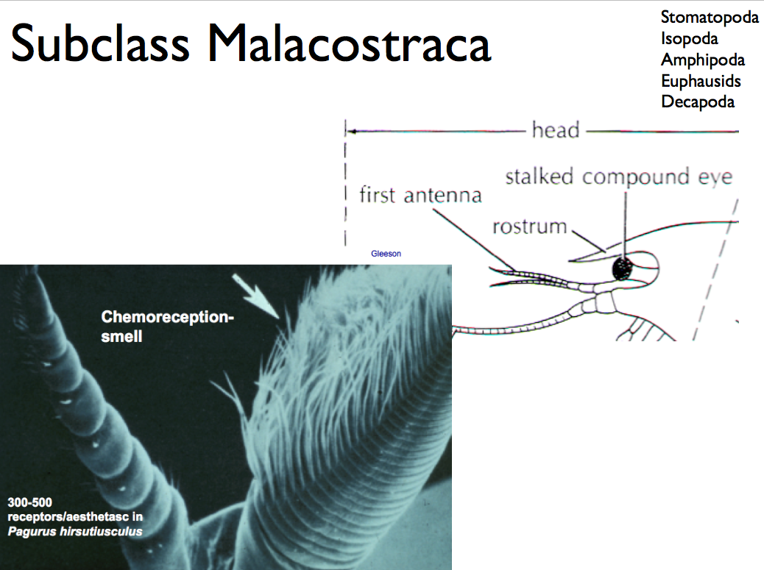

Slide 80
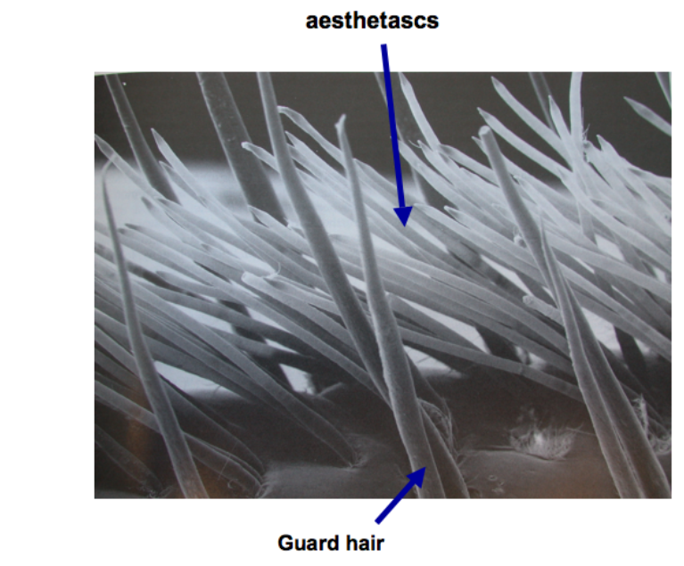

Slide 81
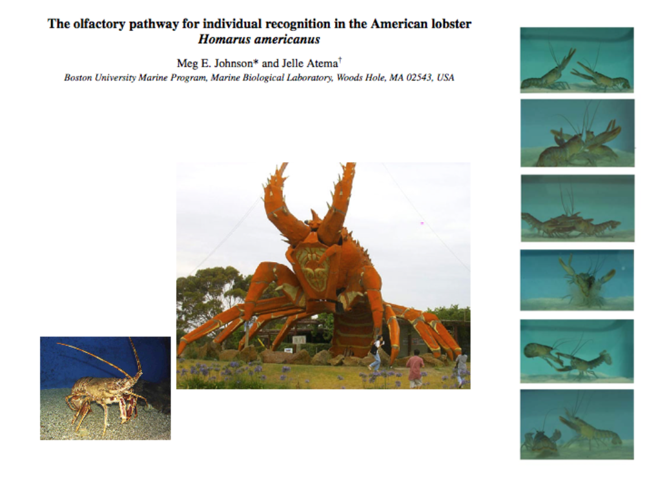

Slide 82
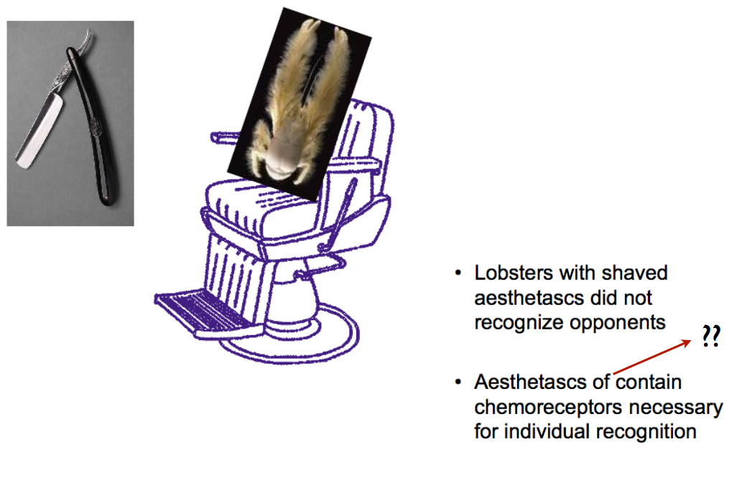

Slide 83
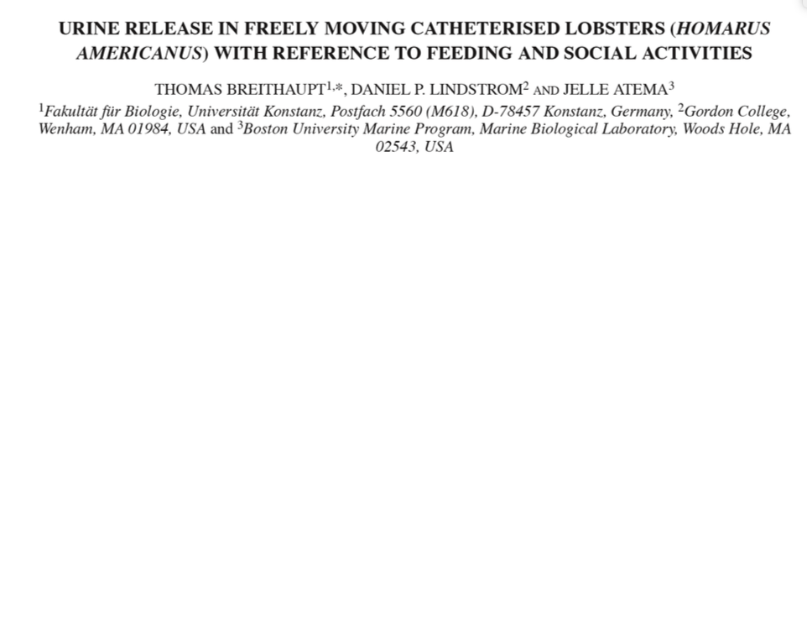

Slide 84
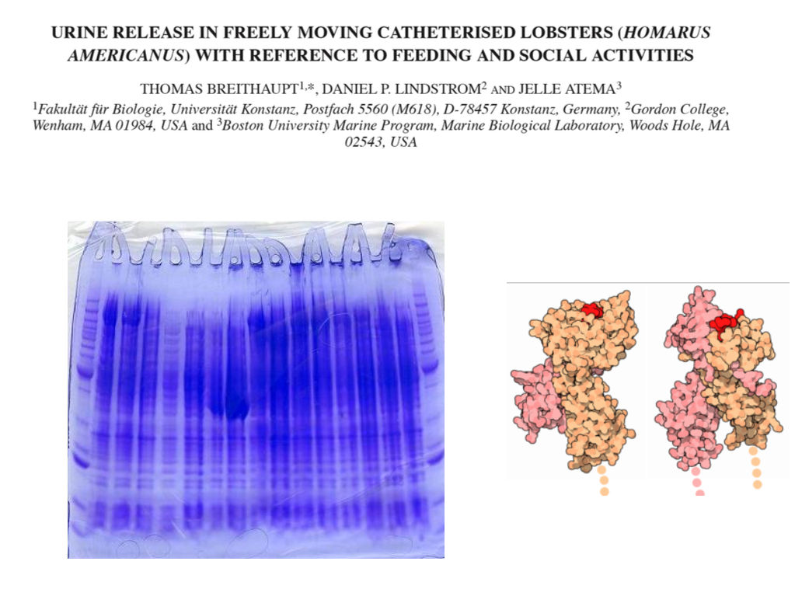

Slide 86
Taste: Detecting Molecules in the Mouth
Taste-sensing chemoreceptors are clustered in structures known as taste buds
In humans taste buds are scattered around the mouth and throat, but mostly are found on the tongue
Each taste bud contains about 100 taste cells, taste receptors that synapse to sensory neurons

Slide 87
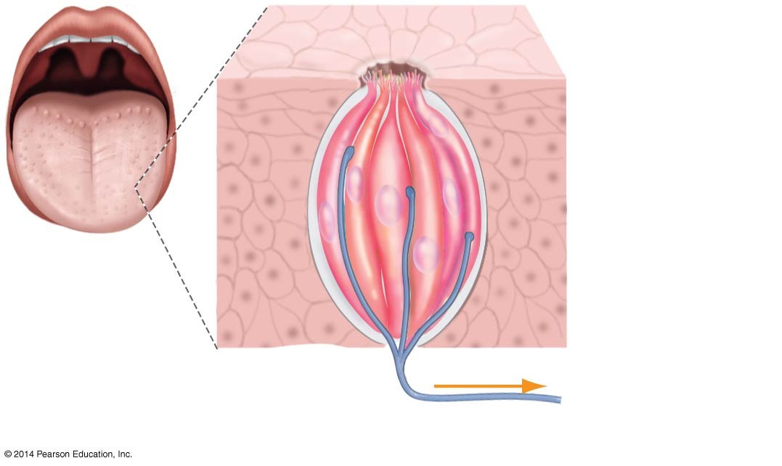
Figure 47.16
Pore
Surface of a
papilla (one of
the “bumps”
on the tongue)
Taste cells
(salt, acid,
sweet, bitter,
meaty, etc.)
Afferent neuron (to brain)
Notes:
Figure 47.16 Taste Buds Contain Many Types of Chemoreceptors.

Slide 88
Salt and Sour
Researchers who analyzed the membrane proteins in taste cells found strong evidence that salt and sour sensations result from the activity of ion channels
The sensation of saltiness is primarily a result of sodium ions dissolved in food
The sodium ions flow into taste cells through open sodium ion channels and depolarize the cell membrane
Sourness results from the presence of protons which flow into taste cells through H ion channels
The molecular mechanisms that lead to the sensations of bitterness and sweetness have been harder to identify

Slide 89
Why Do Many Different Foods Taste Bitter?
Many different types of molecules are perceived as bitter
Researchers recently identified a family of 40–80 genes that encodes transmembrane receptor proteins, each of which binds to just one particular type of bitter molecule
A taste cell can have many different receptor proteins, which explains why so many different molecules give rise to the sensation of bitterness
Bitter receptors may have evolved in response to natural selection for avoiding toxic molecules

Slide 90
The Molecular Basis of Sweetness and Other Tastes
Three closely related membrane receptors combine to form an array of multiunit proteins; some of them respond to sweetness, others to amino acids
The glutamate receptor is responsible for the sensation called umami, which is the meaty taste of the molecule monosodium glutamate (MSG)
A single receptor has binding sites for an array of sugars, meaning that a variety of molecules can stimulate action potentials from the same receptor

Slide 91
Olfaction: Detecting Molecules in the Air
Smell allows animals to monitor airborne molecules that convey information about food sources and the activities of both prey and other members of their own species
When odorants—odor molecules—reach the nose, they diffuse into a mucus layer in the roof of the nose and bind to membrane-bound receptor proteins, activating olfactory receptor neurons
Axons from these neurons project up to the olfactory bulb—the part of the brain where olfactory signals are processed and interpreted

Slide 92
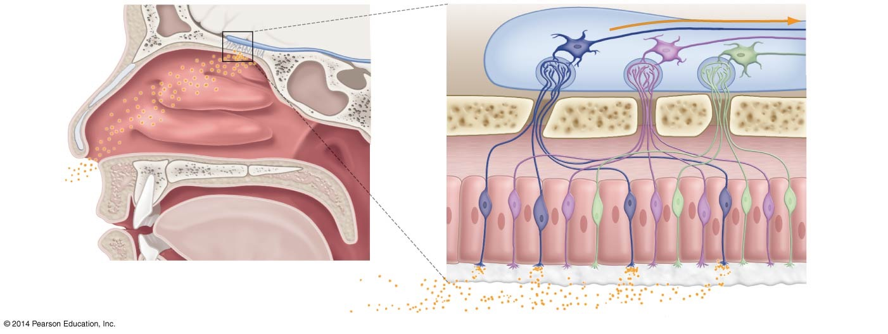
Figure 47.17
Brain
Action potentials
Olfactory
bulb of
brain
Glomeruli
Nasal cavity
Bone
Odor
molecules
Olfactory
receptor
neuron
Mucus
Odor molecules
Notes:
Figure 47.17 In Mammals, Chemoreceptor Cells in the Nose Respond to Specific Odorants.

Slide 93
Olfaction: Detecting Molecules in the Air
Initially, investigators hypothesized that receptors respond to a small set of basic odors, each detected by its own type of receptor
This hypothesis was disproved when researchers Linda Buck and Rachel Axel discovered a large gene family that encodes receptor proteins on the surface of olfactory receptor neurons
Each olfactory neuron has only one type of receptor, and neurons with the same type of receptor project to distinct regions, called glomeruli, in the olfactory bulb

Slide 94
Olfaction: Detecting Molecules in the Air
Follow-up work indicated that particular smells in mice are associated with the activation of a certain subset of the 2000 glomeruli in the brain
In essence, the sense of smell is similar to the visual system’s use of three cones to perceive many colors, but on a much larger scale
Odorant receptors have been discovered in other areas of the vertebrate body: tissues of the heart and pancreas
In addition, the sperm cell contains odorant receptors that aid in fertilization

Slide 95
Pheromones
How are male moths able to locate the female moth from miles away?
The answer lies in the antennae of the male, which can detect a chemical released by the female
The chemical is known as a pheromone
Pheromones are chemicals that are released into the environment and cause a behavioral change

Slide 96
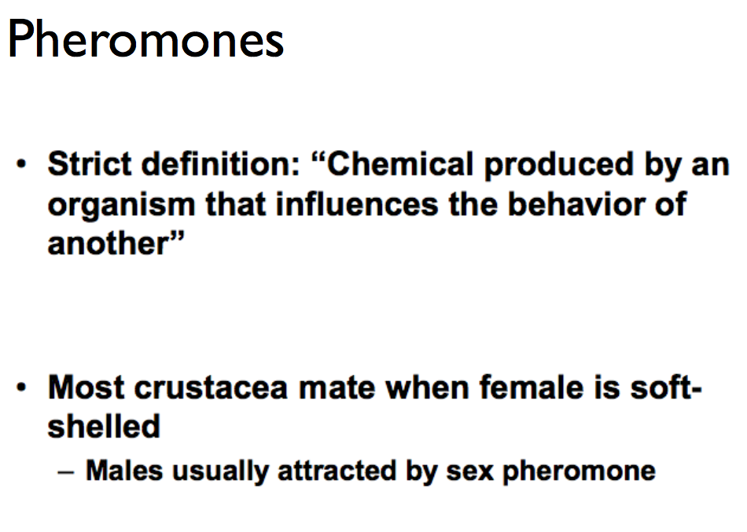

Slide 97
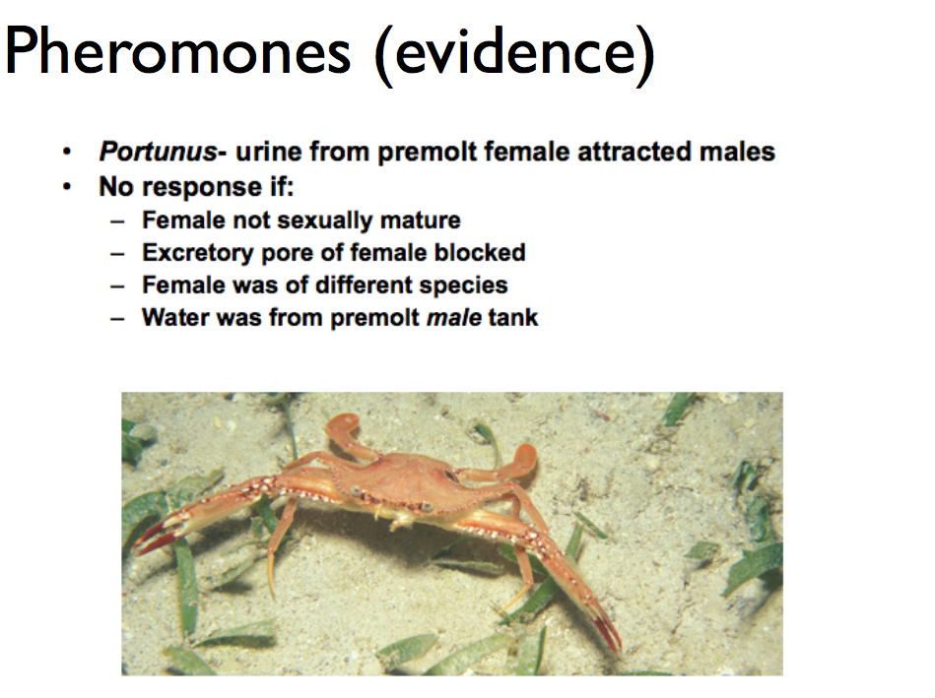

Slide 98
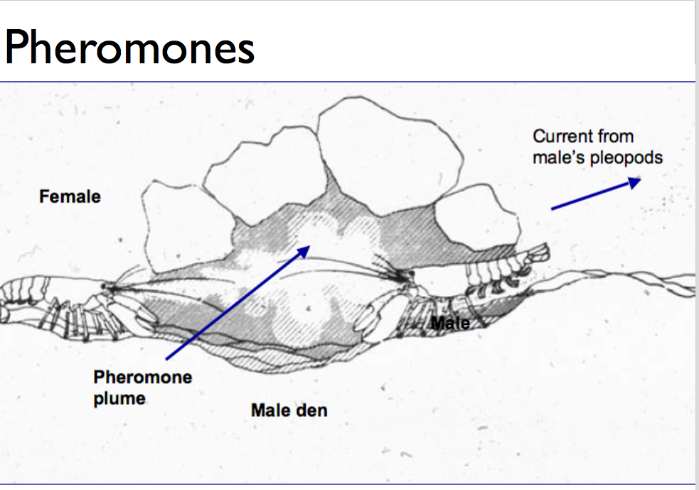

Slide 99
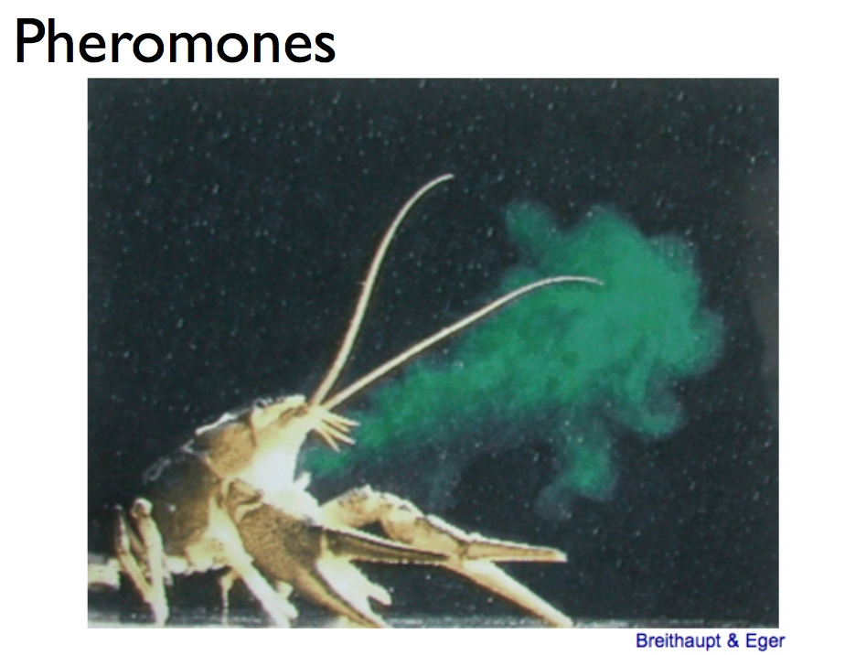

Slide 100
Pheromones and Vomeronasal Organs
In tetrapod vertebrates, vomeronasal organs are sensory organs in the nasal region but different from the olfactory bulb
In these organs, signals are sent to different parts of the brain
For example, a snake may follow its prey by using its vomeronasal organ
The question as to whether humans release pheromones is still unanswered; however, there is a theory that both men and women release molecules from the armpits that can cause behavioral changes

Slide 101
Other Sensory Systems
Two other sensory systems are found in animals:
Electroreception or the sensing of electric fields
In sharks, ampullae of Lorenzini are found in the lateral line
The ampullae are lined with hair cells and respond to electrical polarity, sending signals to the brain
Magnetoreception or sensing magnetic fields found in fish and in migrating birds, where disruption of Earth’s magnetic field can prevent birds from navigating

Slide 102
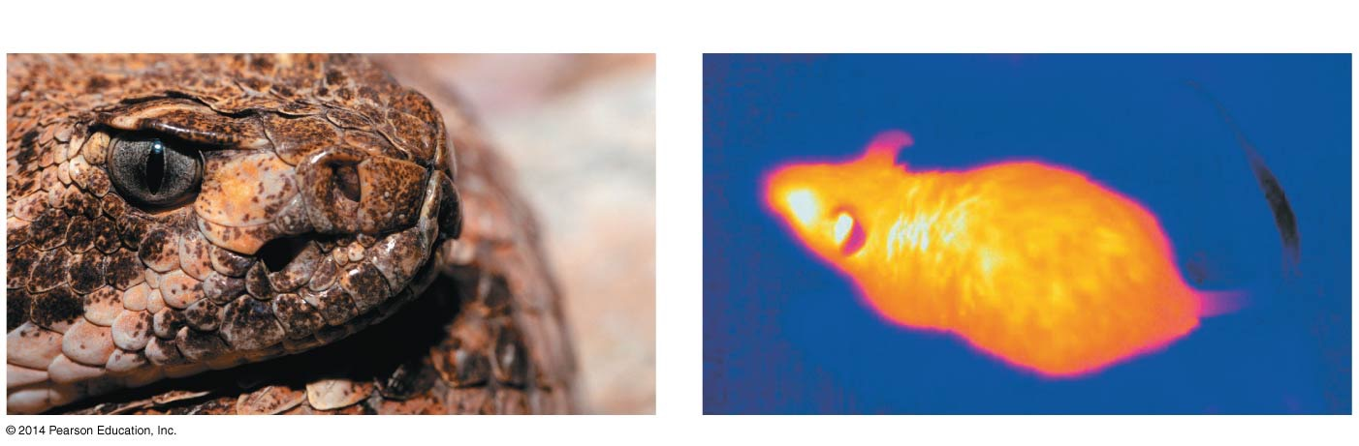
Figure 47.18
(a) Pit vipers have temperature-sensitive pits.
(b) Warm animals emit infrared radiation.
Nostril
Pit
Notes:
Figure 47.18 Pit Vipers Use Thermoreception to Detect Prey.

Slide 103
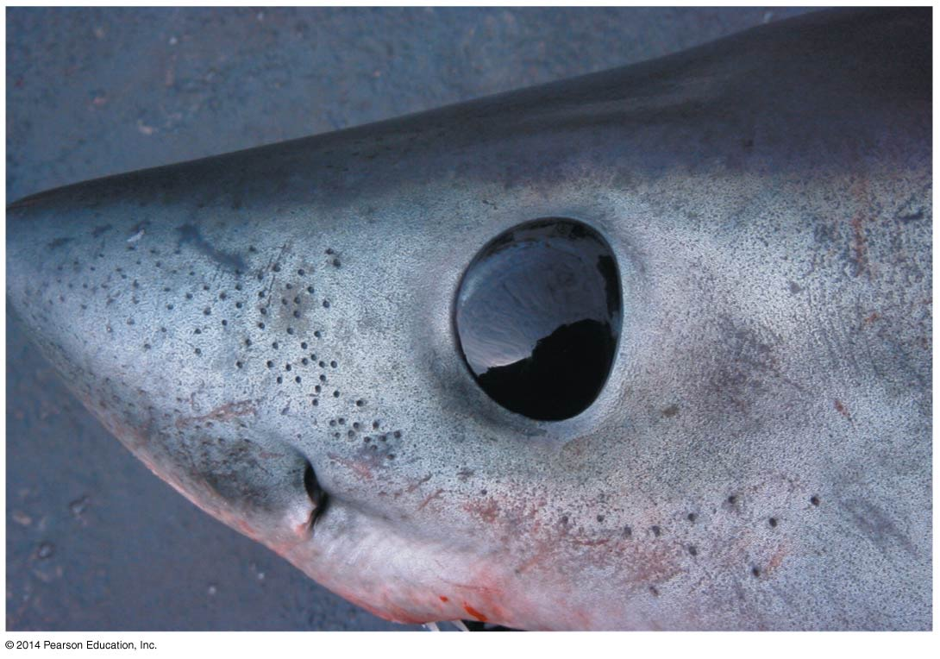
Figure 47.19
Ampullae
of Lorenzini
Notes:
Figure 47.19 Ampullae of Lorenzini on Sharks’ Heads Detect Electrical Fields to Help Locate Prey and Navigate.

Slide 104
Summary
Animals do not use each sense in isolation
They use a combination of senses in responding to changes to their environment

